Slide 1

COMPUTER NETWORKS
(BCSC 0008)
Copyright content, use only with the written permission of presenter mentioned
Lecture 21

Slide 2
Text and Reference Books
Text Books:
Fourouzan B. A. (2004), “Data Communication and Networking”, 4th Edition, McGraw-Hill.
References:
Kurose, J. F. and Ross K. W. (2005), “Computer Networking: A Top-Down Approach Featuring the Internet”, 3rd Edition, Addison-Wesley.
A. S. Tanenbaum (2006), “Computer Networks”, 2nd Edition, Prentice Hall India.

Slide 3
Unicast Routing Protocols:
RIP, OSPF, and BGP
Objectives
Upon completion you will be able to:
Distinguish between intradomain and interdomain routing
Understand distance vector routing and RIP
Understand link state routing and OSPF
Understand path vector routing and BGP

Slide 4
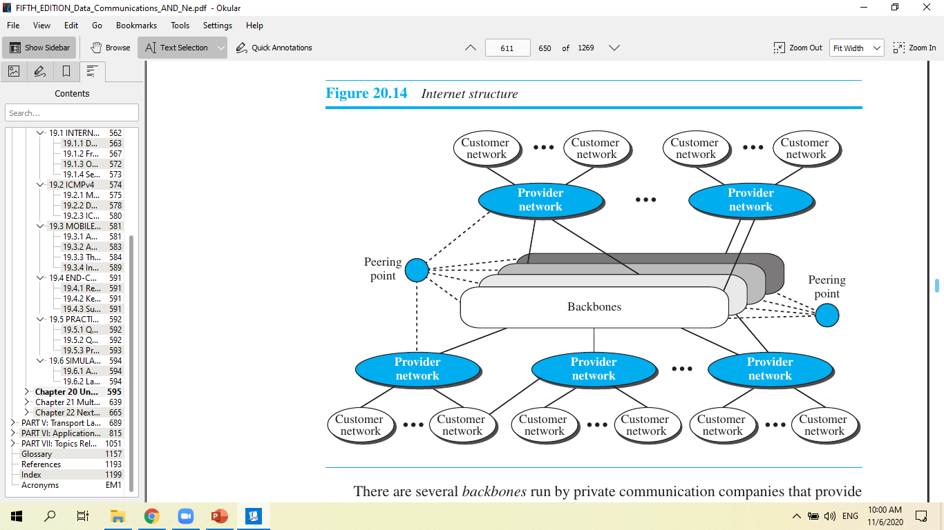

Slide 5
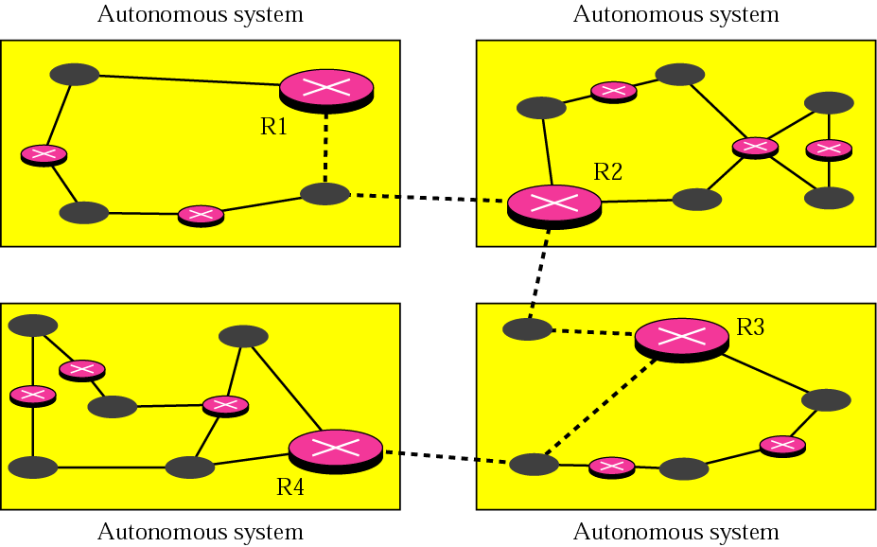
Figure 14.1 Autonomous systems
An autonomous system is a set of networks and routers under
the control of a single administrative authority.
Routing within an autonomous system is intradomain routing.
Routing between autonomous systems is interdomain routing.

Slide 6
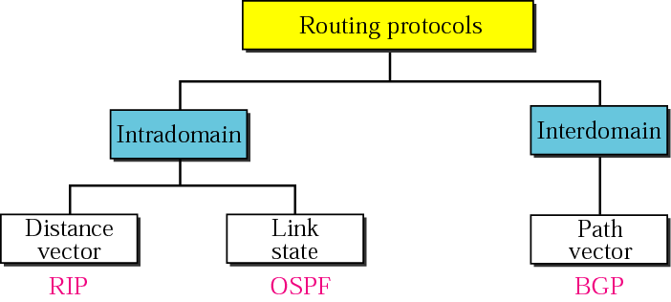
Figure 14.2 Popular routing protocols

Slide 7
14.2 DISTANCE VECTOR ROUTING
In distance vector routing, the least cost route between any two nodes is the route with minimum distance. In this protocol each node maintains a vector (table) of minimum distances to every node
The topics discussed in this section include:
Initialization
Sharing
Updating
When to Share
Two-Node Loop Instability
Three-Node Instability

Slide 8
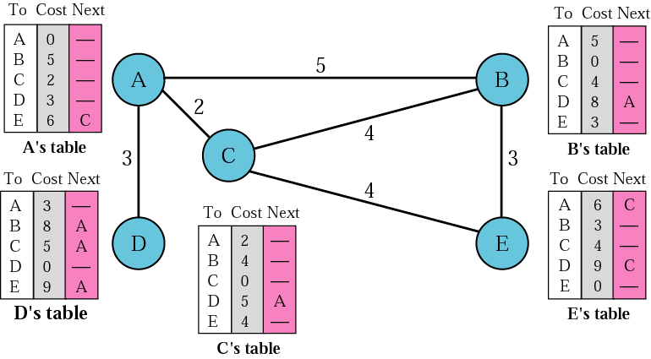
Figure 14.3 Distance vector routing tables

Slide 9
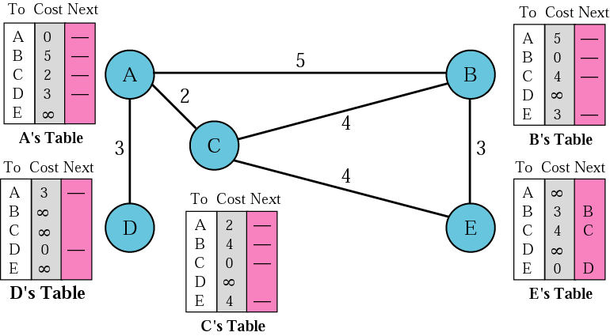
Figure 14.4 Initialization of tables in distance vector routing
In distance vector routing, each node shares its table with its immediate neighbor periodically (eg every 30s) and when
there is a change.

Slide 10
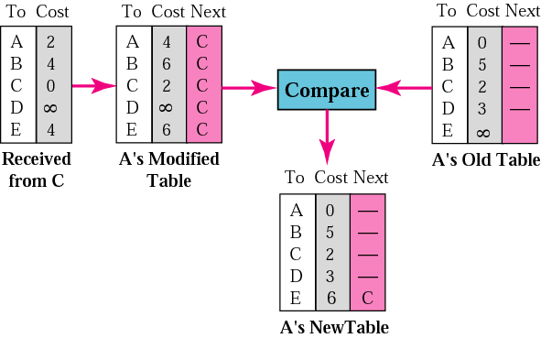
Figure 14.5 Updating in distance vector routing
Step 1: Add cost (2) to table received from neighbor (C).
Step 2: Compare Modified Table with Old Table (row by row).
If Next node entry is different, select the row with the smaller
cost. If tie, keep the old one.
If Next node entry the same, select the new row value (regard-
less of whether new value is smaller or not).

Slide 11
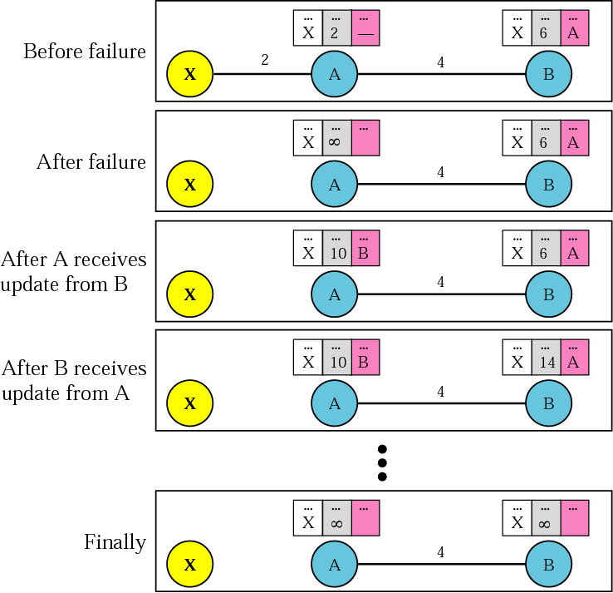
Figure 14.6 Two-node instability – what can happen with distance vector routing
Both A and B know
where X is.
Link between A and X
fails. A updates its
table immediately.
But before A can tell B,
B sends its info to A!
A, using B’s info, up-
dates its table (error!).
Then A send its table
to B and B updates its
table (more error).
Both routers keep up-
dating tables, eventually
hitting infinity. In
the meantime, chaos!

Slide 12
Figure 14.6 Two-node instability – what can happen with distance vector routing
Possible Solutions to two-node instability:
1. Define infinity to be a much smaller value, such as 100. Then it doesn’t take too long to become stable. But now you can’t use distance vector routing in large networks.
2. Split Horizon – instead of flooding entire table to each node, only part of its table is sent. More precisely, if node B thinks that the optimum router to reach X is via A, then B does not need to advertise this piece of info to A – the info has already come from A.
3. Split Horizon and Poison Reverse – Normally, the distance vector protocol uses a timer. If there is no news about a route, the node deletes the route from its table. So when A never hears from B about the route to X, it deletes it. Instead, Node B still advertises the value for X, but if the source of info is A, it replaces the distance with infinity, saying “Do not use this value; what I know about this route comes from you.”

Slide 13
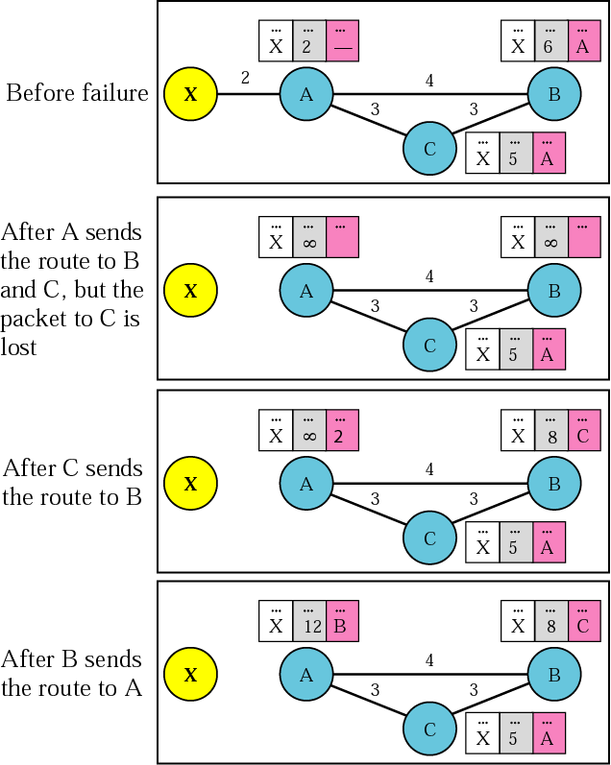
Three-node instability – no solutions here!

Slide 14
14.3 RIP
The Routing Information Protocol (RIP) is an intradomain routing protocol used inside an autonomous system. It is a very simple protocol based on distance vector routing.
The topics discussed in this section include:
RIP Message Format
Requests and Responses
Timers in RIP
RIP Version 2
Encapsulation

Slide 15
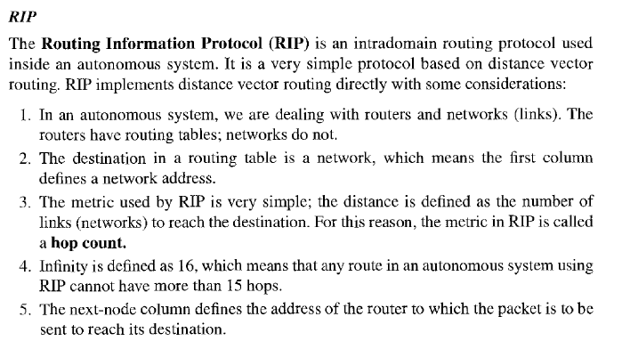

Slide 16
RIP implements the same algorithm as the distance-vector routing algorithm we discussed in the previous section. However, some changes need to be made to the algorithm to enable a router to update its forwarding table:
❑ Instead of sending only distance vectors, a router needs to send the whole contents of its forwarding table in a response message.
❑ The receiver adds one hop to each cost and changes the next router field to the address of the sending router. We call each route in the modified forwarding table the received route and each route in the old forwarding table the old route.
The received router selects the old routes as the new ones except in the following

Slide 17
three cases:
1. If the received route does not exist in the old forwarding table, it should be added to the route.
2. If the cost of the received route is lower than the cost of the old one, the received route should be selected as the new one.
3. If the cost of the received route is higher than the cost of the old one, but the value of the next router is the same in both routes, the received route should be selected as the new one.

Slide 18
This is the case where the route was actually advertised by the same router in the past, but now the situation has been changed. For example, suppose a neighbor has previously advertised a route to a destination with cost 3, but now there is no path between this neighbor and that destination.
The neighbor advertises this destination with cost value infinity (16 in RIP). The receiving router must not ignore this value even though its old route has a lower cost to the same destination.
The new forwarding table needs to be sorted according to the destination route
(mostly using the longest prefix first).

Slide 19
Timers in RIP
RIP uses three timers to support its operation. The periodic timer controls the advertising of regular update messages. Each router has one periodic timer that is randomly to a number between 25 and 35 seconds (to prevent all routers sending their messages at the same time and creating excess traffic). The timer counts down; when zero reached, the update message is sent, and the timer is randomly set once again.
The expiration timer governs the validity of a route. When a router receives update information for a route, the expiration timer is set to 180 seconds for that particular route. Every time a new update for the route is received, the timer is reset. If there is a problem on internet and no update is received within the allotted 180 seconds, the route is considered expired and the hop count of the route is set to 16, which means the destination unreachable. Every route has its own expiration timer.
The garbage collection timer used to purge a route from the forwarding table. When the information about a route becomes invalid, the router does not immediately purge that route from its table. Instead, it continues to advertise the route with a metric value of 16. At the same time, a garbage collection timer is set to 120 seconds for that route. When the count reaches zero, the route is purged from the table. This timer allows neighbors to become aware of the invalidity of a route prior to purging.

